Slide 1
CYBER RANGE
SIMULATION
Network Vulnerability and Attack Queue System

Slide 2
Table of contents
DATA STRUCTURES AND ALGORITHMS
COURSE:
INSTRUCTOR:
Dr Zubair Ahmed
TEAM MEMBERS:
Abdullah, Warda and Asjid
2024321
2024663
2024119

Slide 3
01
INTRODUCTION

Slide 4

INTRODUCTION
Simulates a basic network defense environment.
Systems are represented as nodes with varying vulnerability levels.
Users can queue attacks on specific IP addresses.
Simulation determines attack success/failure using vulnerability and patching factors.
Demonstrates data structure concepts: arrays, queues, and structures.
Introduces basic cybersecurity logic such as vulnerability scoring and patch impact.

Slide 5
02
OVERVIEW

Slide 6
OVERVIEW
Model a network of interconnected systems using struct SystemNode.
Implement a manual attack queue (struct AttackQueue) in FIFO order.
Simulate attacks based on system vulnerability and patching status.
Demonstrate queue operations — enqueue, dequeue, and status checking (isEmpty, isFull).
Provide an interactive, menu-driven interface for user interaction.

Slide 7
03
SYSTEM DESIGN

Slide 8
SYSTEM DESIGN
Model: network = collection of SystemNodes
Attack requests managed by a fixed-size AttackQueue (FIFO)
Helper functions implement queue ops and exploit logic
Controlled simulation via constants (MAX_SYSTEMS, MAX_QUEUE)

Slide 9
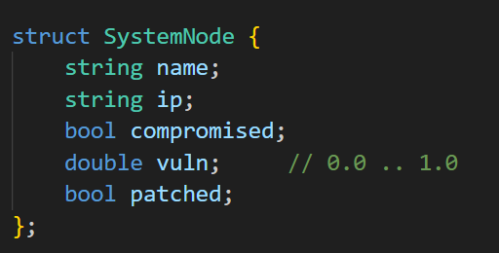
DATA STRUCTURE: SystemNode
SystemNode — represents each host
name — system label (e.g., “Main Server”)
ip — IP address string
compromised — boolean (hacked or not)
vuln — vulnerability score (0.0 – 1.0)
patched — boolean (has patch)
vuln is the base exploitability; patched reduces effective vulnerability.

Slide 10
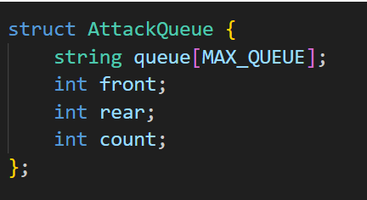
DATA STRUCTURE: AttackQueue
AttackQueue — fixed-size FIFO
Stores IP addresses of attack targets in an array queue[MAX_QUEUE]
front and rear track ends (wrap-around)
count tracks current size
We use front to dequeue and rear to enqueue. count helps quickly check empty/full without scanning

